Slide 1
Household Behavior and Consumer Choice
Dr. Jalandhar Pradhan
Reference: Karl E. Case, Ray C. Fair and Sharon M. Oster: Principles of Economics, Pearson Publisher

Slide 2

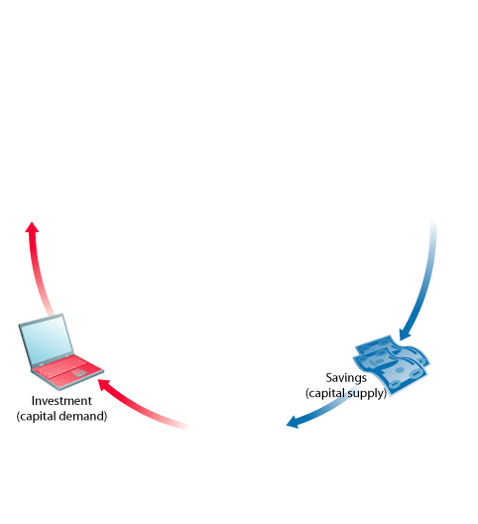


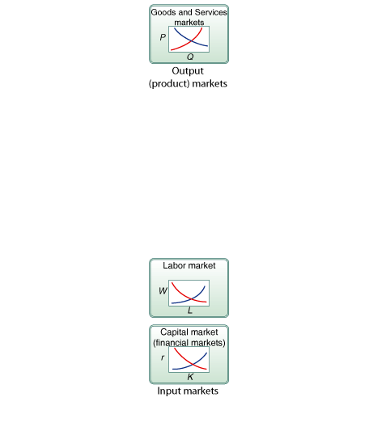
HOUSEHOLD BEHAVIOR AND
CONSUMER CHOICE
FIGURE 1 Firm and Household Decisions
<number> of 40

Slide 3
HOUSEHOLD BEHAVIOR AND
CONSUMER CHOICE
perfect knowledge The assumption that households possess a knowledge of the qualities and prices of everything available in the market and that firms have all available information concerning wage rates, capital costs, and output prices.
Much of the economic analysis in the chapters that follow applies to all forms of market
structure. Indeed, much of the power of economic reasoning is that it is quite general. As we continue in microeconomics, in Chapter 13 we will define and explore several different kinds of market organization and structure, including monopoly, oligopoly, and monopolistic competition. Because monopolists, oligopolists, monopolistic competitors, and perfect competitors share the objective of maximizing profits, it should not be surprising that their behavior is in many ways similar. We focus here on perfect competition because many of these basic principles are easier to learn in the simplest of cases first.
<number> of 40

Slide 4
HOUSEHOLD CHOICE IN OUTPUT MARKETS
Every household must make three basic decisions:
How much of each product, or output, to demand
2. How much labor to supply
3. How much to spend today and how much to save for the future
<number> of 40

Slide 5
HOUSEHOLD CHOICE IN OUTPUT MARKETS
THE DETERMINANTS OF HOUSEHOLD DEMAND
Several factors influence the quantity of a given good or service demanded by a single household:
■ The price of the product
■ The income available to the household
■ The household’s amount of accumulated wealth
■ The prices of other products available to the household
■ The household’s tastes and preferences
■ The household’s expectations about future income, wealth, and prices
<number> of 40

Slide 6
HOUSEHOLD CHOICE IN OUTPUT MARKETS
THE BUDGET CONSTRAINT
Information on household income and wealth, together with information on product prices, makes it possible to distinguish those combinations of goods and services that are affordable from those that are not.
budget constraint The limits imposed on household choices by income, wealth,
and product prices.
<number> of 40

Slide 7
HOUSEHOLD CHOICE IN OUTPUT MARKETS
TABLE 1 Possible Budget Choices of a Person Earning $1,000 Per Month After Taxes
OPTION | MONTHLY RENT | FOOD | OTHER EXPENSES | TOTAL | AVAILABLE?
A | $ 400 | $250 | $350 | $1,000 | Yes
B | 600 | 200 | 200 | 1,000 | Yes
C | 700 | 150 | 150 | 1,000 | Yes
D | 1,000 | 100 | 100 | 1,200 | No
choice set or opportunity set The set of options that is defined and limited by a budget constraint.
<number> of 40

Slide 8
HOUSEHOLD CHOICE IN OUTPUT MARKETS
Preferences, Tastes, Trade-Offs, and Opportunity Cost
Preferences play a key role in
determining demand. Some
people like the blues or jazz,
some like classical, while
others love country music.
As long as a household faces a limited budget—and all households ultimately do—the real cost of any good or service is the value of the other goods and services that could have been purchased with the same amount of money. The real cost of a good or service is its opportunity cost, and opportunity cost is determined by relative prices.
<number> of 40

Slide 9
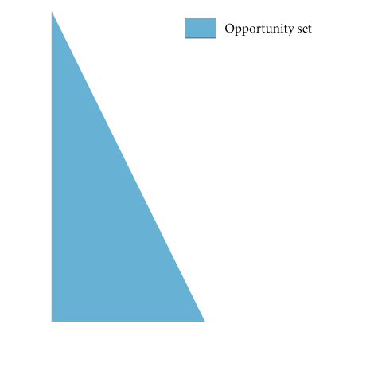
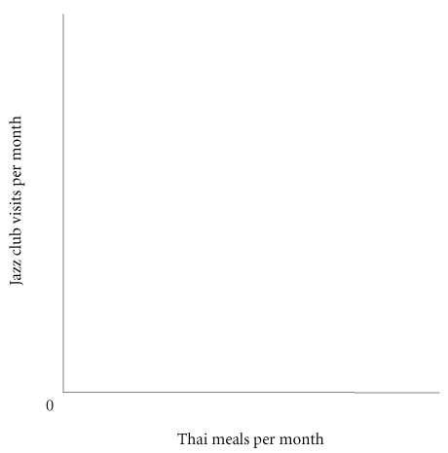
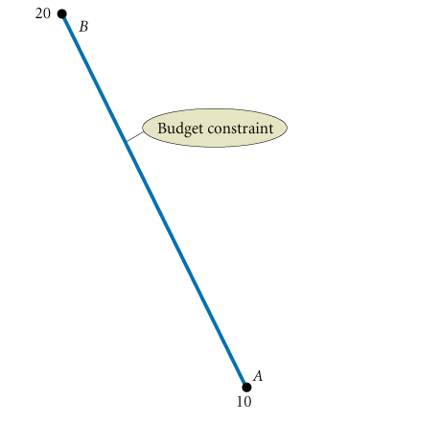
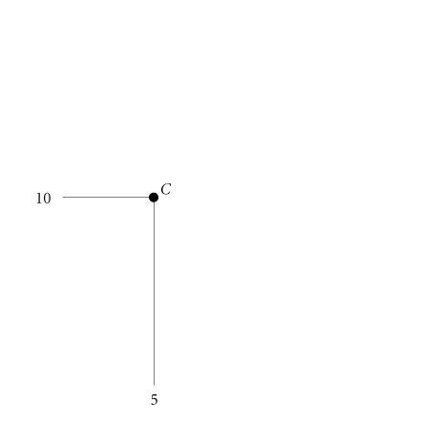
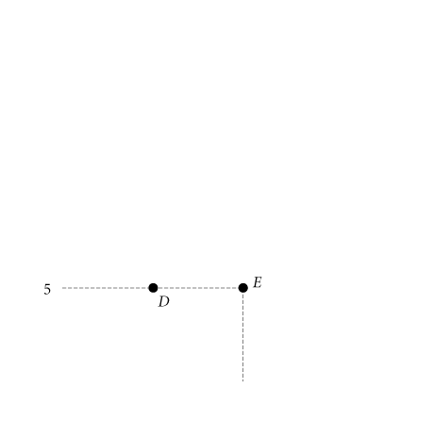
HOUSEHOLD CHOICE IN OUTPUT MARKETS
The Budget Constraint More Formally
FIGURE 3 Budget Constraint and Opportunity Set for Ann and Tom
<number> of 40

Slide 10
HOUSEHOLD CHOICE IN OUTPUT MARKETS
real income Set of opportunities to purchase real goods and services available to a household as determined by prices and money income.
<number> of 40

Slide 11
HOUSEHOLD CHOICE IN OUTPUT MARKETS
THE EQUATION OF THE BUDGET CONSTRAINT
In general, the budget constraint can be written:
P_{X}X + P_{Y}Y = I,
where P_{X} = the price of X, X = the quantity of X consumed, P_{Y} = the price of Y, Y = the quantity of Y consumed, and I = household income.
<number> of 40

Slide 12
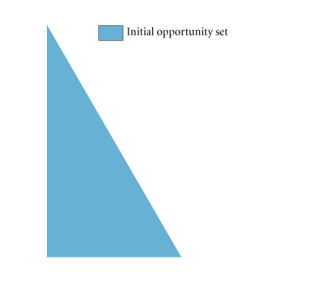
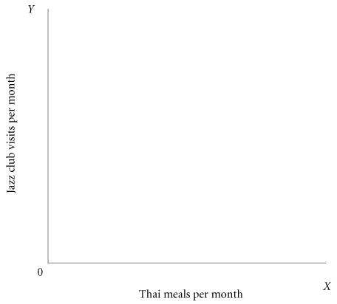
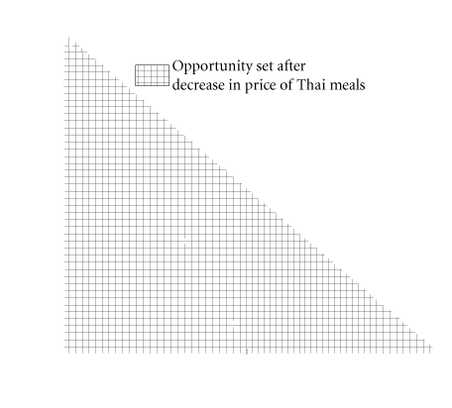
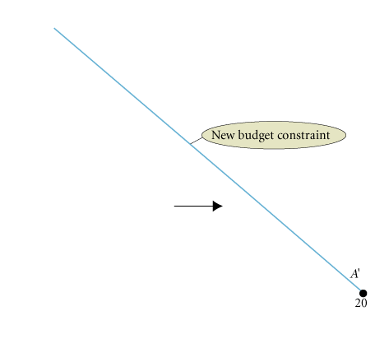
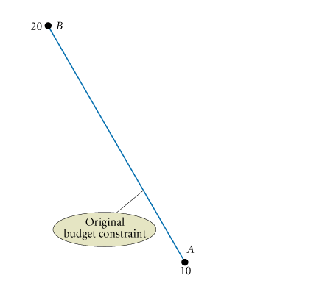
HOUSEHOLD CHOICE IN OUTPUT MARKETS
Budget Constraints Change When Prices Rise or Fall
FIGURE 4 The Effect of a Decrease in Price on Ann and Tom’s Budget Constraint
The budget constraint is defined by income, wealth, and prices. Within those limits, households are free to choose, and the household’s ultimate choice depends on its own likes and dislikes.
<number> of 40

Slide 13
THE BASIS OF CHOICE: UTILITY
utility The satisfaction, or reward, a product yields relative to its alternatives. The basis of choice.
<number> of 40

Slide 14
THE BASIS OF CHOICE: UTILITY
DIMINISHING MARGINAL UTILITY
marginal utility (MU) The additional satisfaction gained by the consumption or use of one more unit of something.
total utility The total amount of satisfaction obtained from consumption
of a good or service.
law of diminishing marginal utility The more of any one good consumed in a given period, the less satisfaction (utility)
generated by consuming each additional (marginal) unit of the same good.
<number> of 40

Slide 15


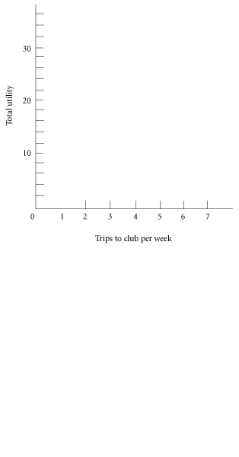


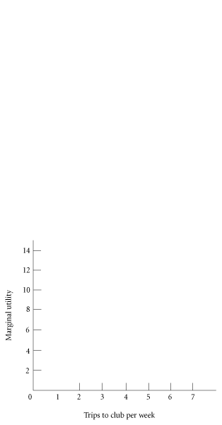


THE BASIS OF CHOICE: UTILITY
TABLE 2 Total Utility and Marginal Utility of Trips to the Club Per Week
TRIPS TO CLUB | TOTAL UTILITY | MARGINAL UTILITY
1 | 12 | 12
2 | 22 | 10
3 | 28 | 6
4 | 32 | 4
5 | 34 | 2
6 | 34 | 0
FIGURE 5 Graphs of Frank’s Total and Marginal Utility
<number> of 40

Slide 16
THE BASIS OF CHOICE: UTILITY
ALLOCATING INCOME TO MAXIMIZE UTILITY
TABLE 3 Allocation of Fixed Expenditure per Week Between Two Alternatives
(1) TRIPS TO CLUB PER WEEK | (2) TOTAL UTILITY | (3) MARGINAL UTILITY (MU) | (4) PRICE (P) | (5) MARGINAL UTILITY PER DOLLAR (MU/P)
1 | 12 | 12 | $3.00 | 4.0
2 | 22 | 10 | 3.00 | 3.3
3 | 28 | 6 | 3.00 | 2.0
4 | 32 | 4 | 3.00 | 1.3
5 | 34 | 2 | 3.00 | 0.7
6 | 34 | 0 | 3.00 | 0
(1) BASKETBALL GAMES PER WEEK | (2) TOTAL UTILITY | (3) MARGINAL UTILITY (MU) | (4) PRICE (P) | (5) MARGINAL UTILITY PER DOLLAR (MU/P)
1 | 21 | 21 | $6.00 | 3.5
2 | 33 | 12 | 6.00 | 2.0
3 | 42 | 9 | 6.00 | 1.5
4 | 48 | 6 | 6.00 | 1.0
5 | 51 | 3 | 6.00 | .5
6 | 51 | 0 | 6.00 | 0
<number> of 40

Slide 17

THE BASIS OF CHOICE: UTILITY
THE UTILITY-MAXIMIZING RULE
In general, utility-maximizing consumers spread out their expenditures until the following condition holds:
<number> of 40

Slide 18
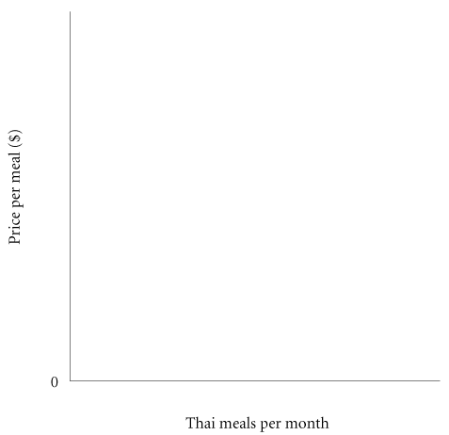
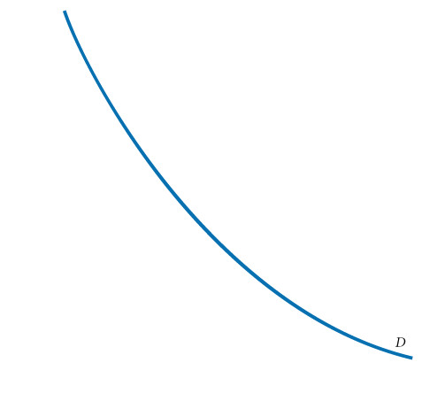

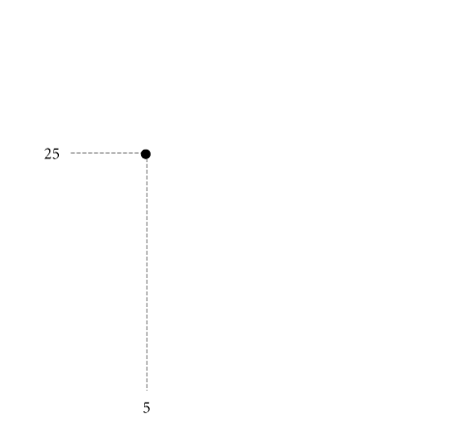
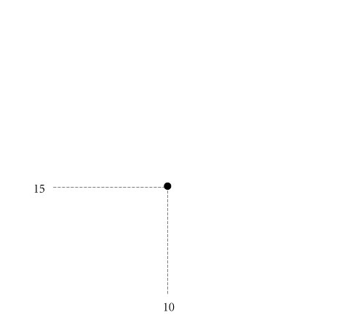

THE BASIS OF CHOICE: UTILITY
DIMINISHING MARGINAL UTILITY AND DOWNWARD-SLOPING DEMAND
FIGURE 6 Diminishing Marginal Utility and Downward-Sloping Demand
<number> of 40

Slide 19
INCOME AND SUBSTITUTION EFFECTS
THE INCOME EFFECT
When the price of something we buy falls, we are better off. When the price of something we buy rises, we are worse off.
<number> of 40

Slide 20
INCOME AND SUBSTITUTION EFFECTS
THE SUBSTITUTION EFFECT
Both the income and the substitution effects imply a negative relationship between price and quantity demanded—in other words, downward-sloping demand. When the price of something falls, ceteris paribus, we are better off, and we are likely to buy more of that good and other goods (income effect). Because lower price also means “less expensive relative to substitutes,” we are likely to buy more of the good (substitution effect). When the price of something rises, we are worse off, and we will buy less of it (income effect). Higher price also means “more expensive relative to substitutes,” and we are likely to buy less of it and more of other goods (substitution effect).
<number> of 40

Slide 21
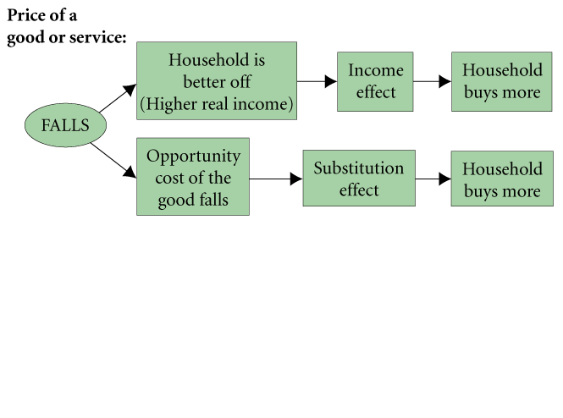
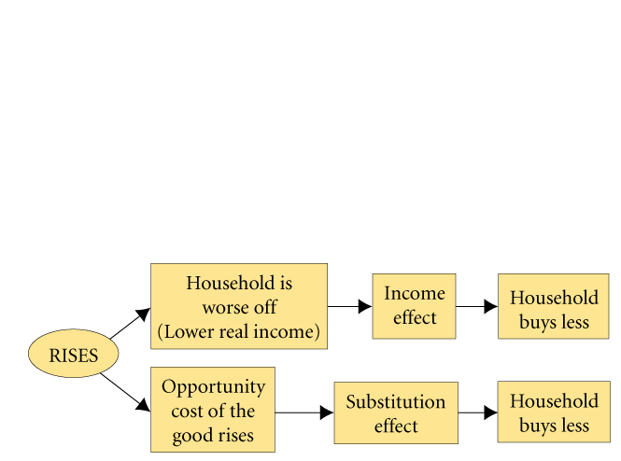
INCOME AND SUBSTITUTION EFFECTS
FIGURE 7 Income and Substitution Effects of a Price Change
<number> of 40

Slide 22
CONSUMER SURPLUS
consumer surplus The difference between the maximum amount a person is willing to pay for a good and its current market price.
diamond/water paradox A paradox stating that (1) the things with the greatest value in use frequently have little or no value in exchange, and (2) the things with the greatest value in exchange frequently have little or no value in use.
<number> of 40

Slide 23
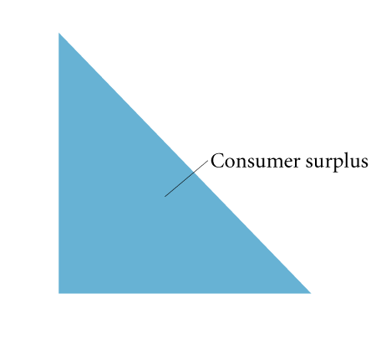
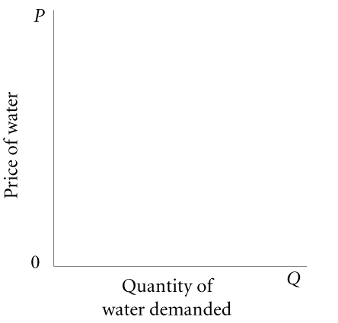

CONSUMER SURPLUS
FIGURE 8 The Diamond/Water Paradox
cost-benefit analysis The formal technique by which the benefits of a public project are weighed against its costs.
<number> of 40

Slide 24
REVIEW TERMS AND CONCEPTS
budget constraint
choice set or opportunity set
consumer surplus
cost-benefit analysis
diamond/water paradox
financial capital market
homogeneous products
income effect of a price change
labor supply curve
law of diminishing marginal utility
marginal utility (MU)
perfect competition
perfect knowledge
real income
substitution effect of a price change
total utility
utility
utility-maximizing rule
<number> of 40

Slide 25
Appendix
INDIFFERENCE CURVES
ASSUMPTIONS
We base the following analysis on four assumptions:
We assume that this analysis is restricted to goods that yield positive marginal utility, or, more simply, that “more is better.”
The marginal rate of substitution is defined as MU_{X}/MU_{Y}, or the ratio at which a household is willing to substitute X for Y. We assume a diminishing marginal rate of substitution.
We assume that consumers have the ability to choose among the combinations of goods and services available.
We assume that consumer choices are consistent with a simple assumption of rationality.
<number> of 40

Slide 26
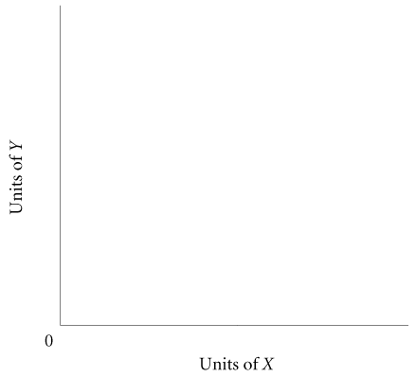

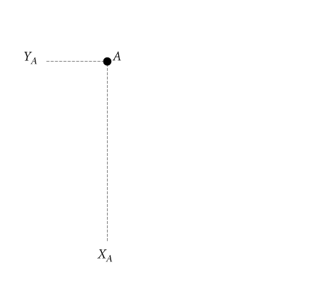
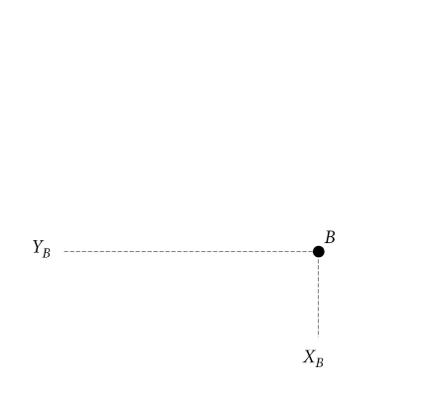
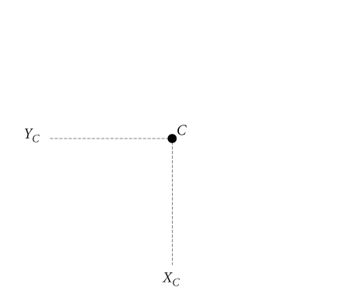

Appendix
DERIVING INDIFFERENCE CURVES
An indifference curve is a set of points, each point representing a combination of goods X and Y, all of which yield the same total utility.
FIGURE 9 An Indifference Curve
<number> of 40

Slide 27
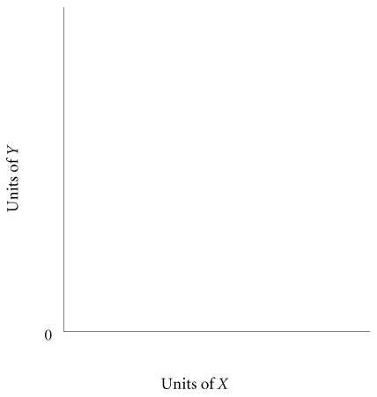
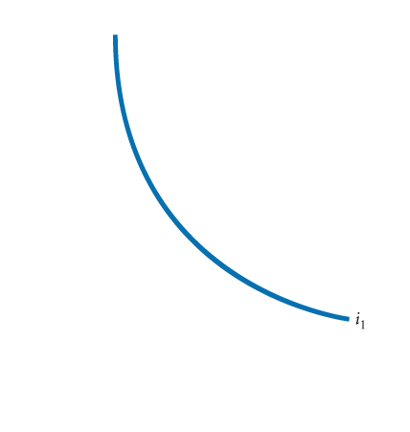
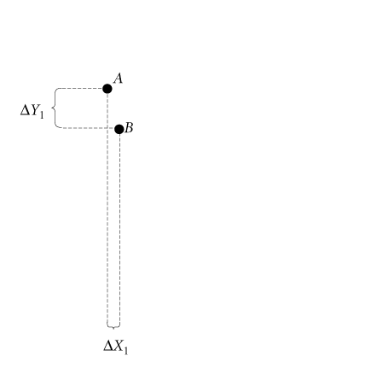
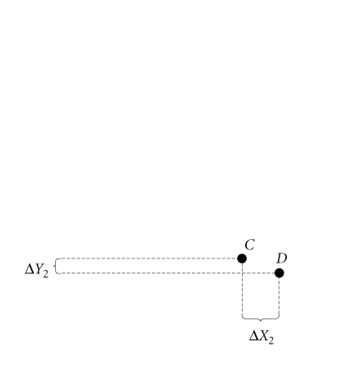

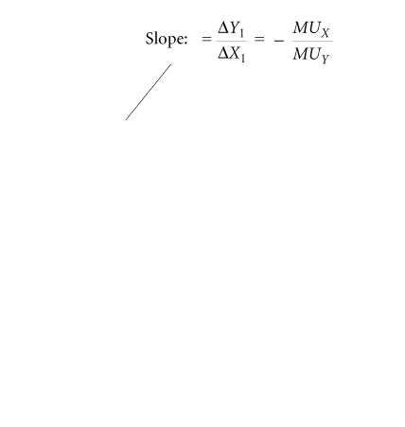
Appendix
The shapes of the indifference curves depend on the preferences of the consumer, and the whole set of indifference curves is called a preference map.
FIGURE 10 A Preference Map: A Family of Indifference Curves
<number> of 40

Slide 28

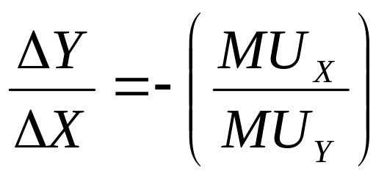
Appendix
PROPERTIES OF INDIFFERENCE CURVES
If we divide both sides by MU_{Y} and by ΔX, we obtain
The slope of an indifference curve is the ratio of the marginal utility of X to the marginal utility of Y, and it is negative.
<number> of 40

Slide 29
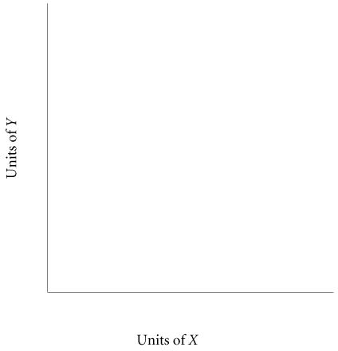
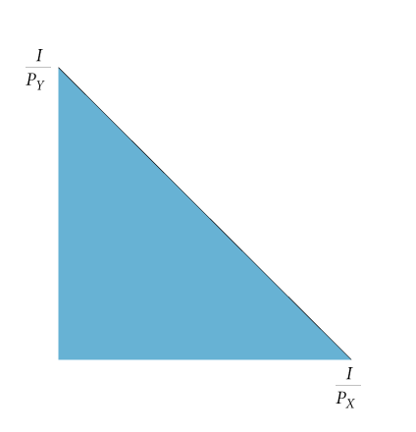
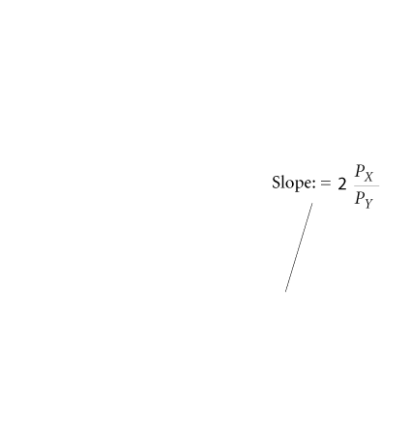

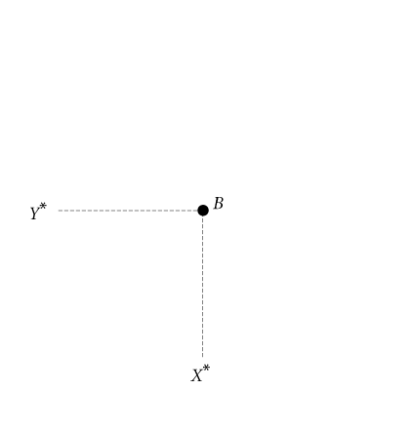
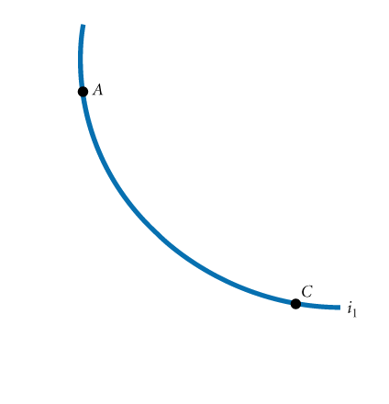

Appendix
CONSUMER CHOICE
FIGURE 11 Consumer Utility-Maximizing
Equilibrium
As long as indifference curves are convex to the origin, utility maximization will take place at the point at which the indifference curve is just tangent to the budget constraint.
<number> of 40

Slide 30
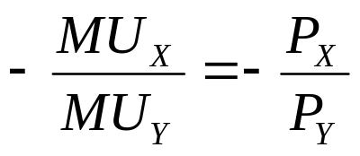
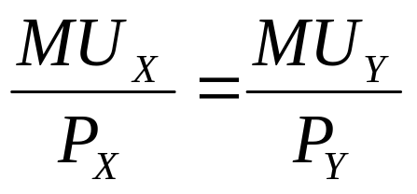
Appendix
Where two curves are tangent, they have the same slope, which implies that the slope of the indifference curve is exactly equal to the slope of the budget constraint at the point of tangency:
slope of indifference curve = slope of budget constraint
By multiplying both sides of this equation by MU_{Y} and dividing both sides by P_{X}, we can rewrite this utility-maximizing rule as
<number> of 40

Slide 31

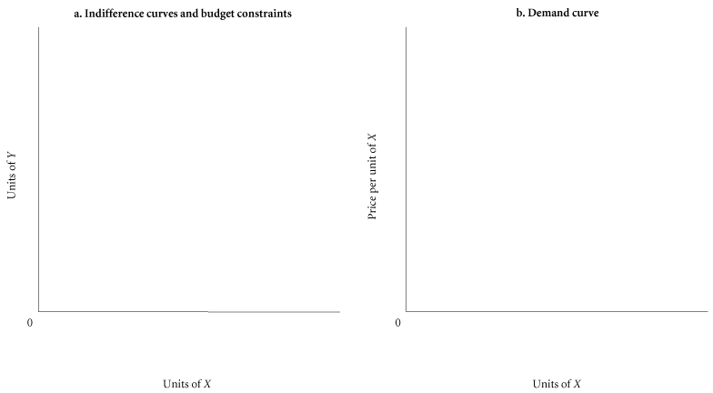
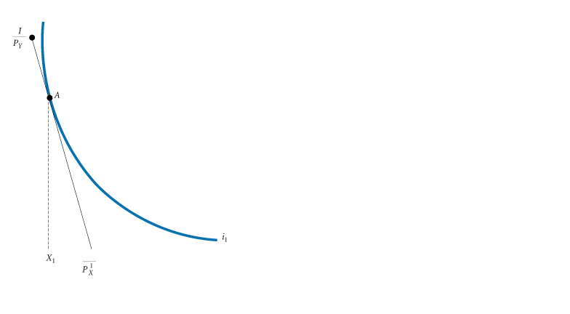
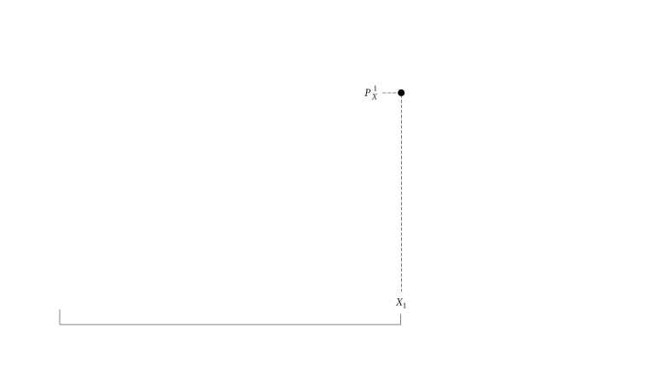
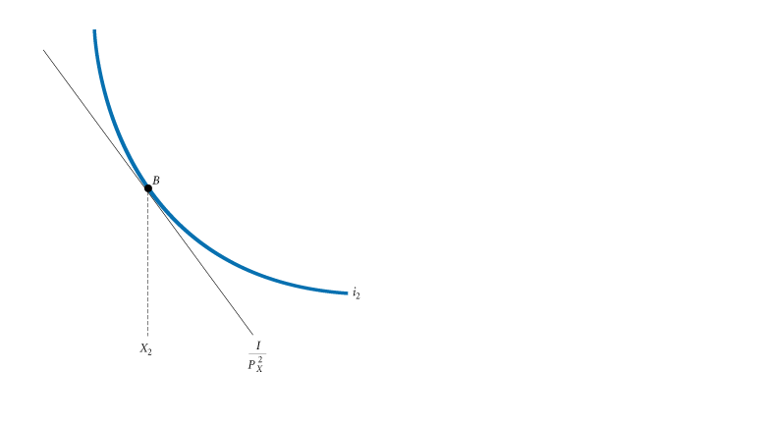
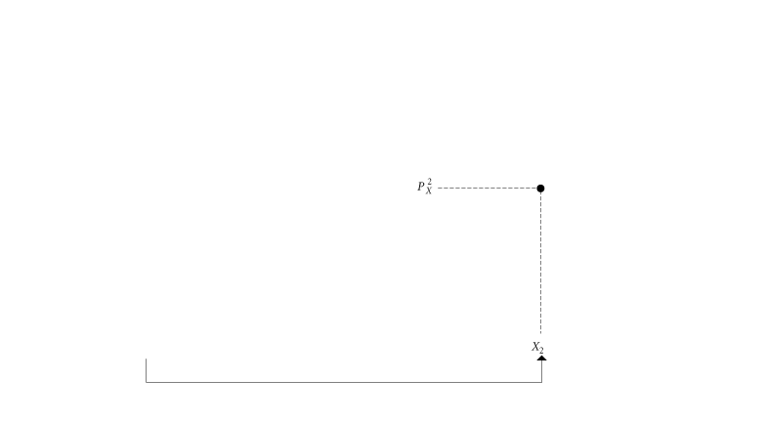
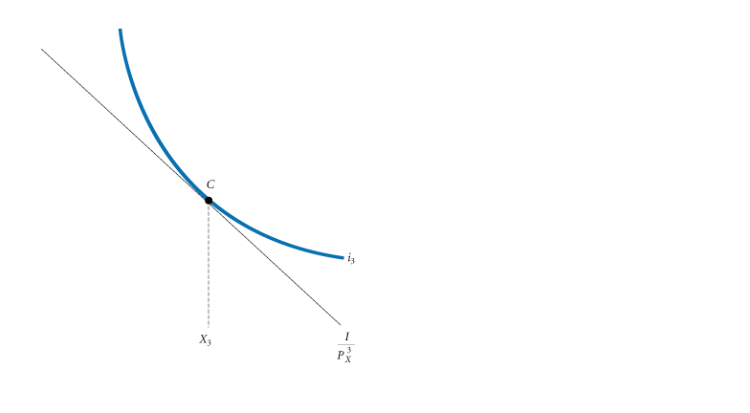

Appendix
DERIVING A DEMAND CURVE FROM INDIFFERENCE CURVES AND BUDGET CONSTRAINTS
FIGURE 12 Deriving a Demand Curve from Indifference Curves and Budget Constraint
<number> of 40

